Slide 1
Discrete Mathematics BCSC 0010
Module 2 Propositional logic

Slide 2
Introduction
A proposition is a declarative statement which is either true or false, but not both.

Slide 3
Examples
All the following declarative sentences are propositions.
1. Delhi is the capital of India.
2. Toronto is the capital of Canada.
3. 1 + 1 = 2.
4. 2+2 = 3.
Propositions 1 and 3 are true, whereas 2 and 4 are false

Slide 4
Consider the following sentences
1. What time is it?
2. Read this carefully.
3. x + 1 = 2.
4. x + y = z.
Sentences 1 and 2 are not propositions because they are not declarative sentences.
Sentences 3 and 4 are not propositions because they are neither true nor false

Slide 5
Examples
(i) Ice floats in water.
(ii) China is in Europe.
(iii) 2 + 2 = 4
(iv) 2 + 2 = 5
(v) Where are you going?
(vi) Do your homework.
The first four are propositions, the last two are not.
Also, (i) and (iii) are true, but (ii) and (iv) are false.
These are called primitive propositions

Slide 6
Propositional variables
We use letters to denote propositions
These letters are called propositional variables (or statement variables)
The conventional letters used for propositional variables are p,q,r,s.... or P,Q,R,S,…..
Example : P=Lucknow is the capital of U.P.

Slide 7
The truth value of a proposition is denoted by T (True) or F (False)
The area of logic that deals with propositions is called the propositional calculus or propositional logic.

Slide 8
Compound Propositions
Many mathematical statements are constructed by combining one or more propositions.
New propositions, called compound propositions, are formed from existing propositions using logical operators(connectives).

Slide 9
Compound Propositions
A proposition is said to be primitive if it cannot be broken down into simpler propositions.
A propositions is said to be composite if it is composed of subpropositions which are connected with the help of various connectives .
Such composite propositions are called compound propositions.

Slide 10
Examples
“Roses are red and violets are blue.”
“John is smart or he studies every night.”

Slide 11
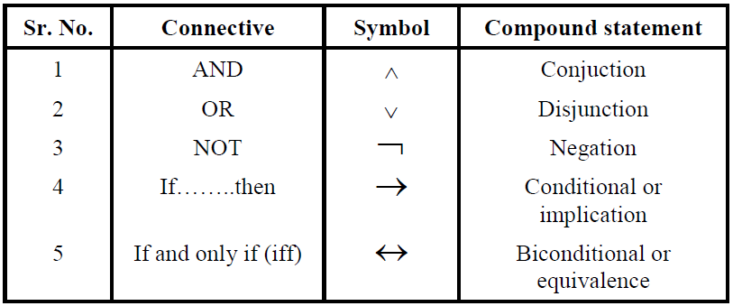
Logical Connectives/Sentence Connectives
Words or symbols used to combine two sentences to form compound sentences

Slide 12
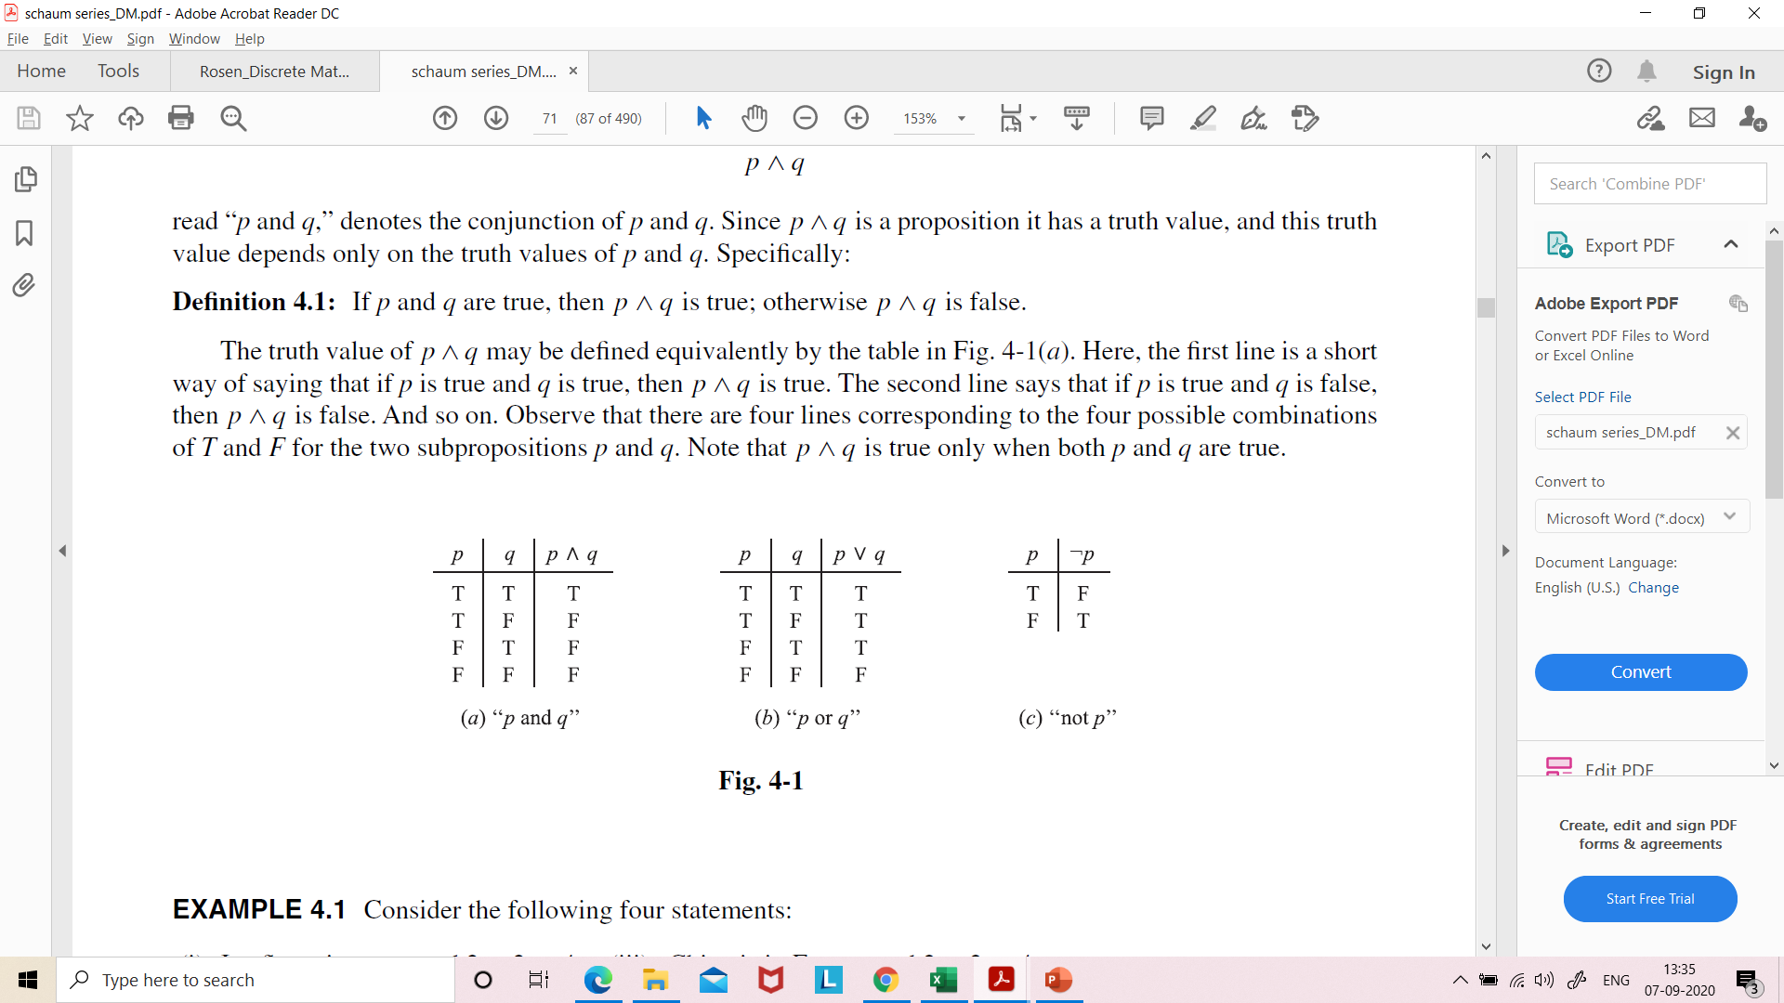
Conjunction, p ∧ q
Any two propositions can be combined by the word “and” to form a compound proposition called the conjunction of the original propositions.
Symbolically, p ∧ q read “p and q,”
If p and q both are true, then p ∧ q is true; otherwise p ∧ q is false.

Slide 13
Example
If p is the proposition “Today is Friday”
and q is the proposition “It is raining today”
Then p ∧ q will be
Today is Friday and it is raining today

Slide 14
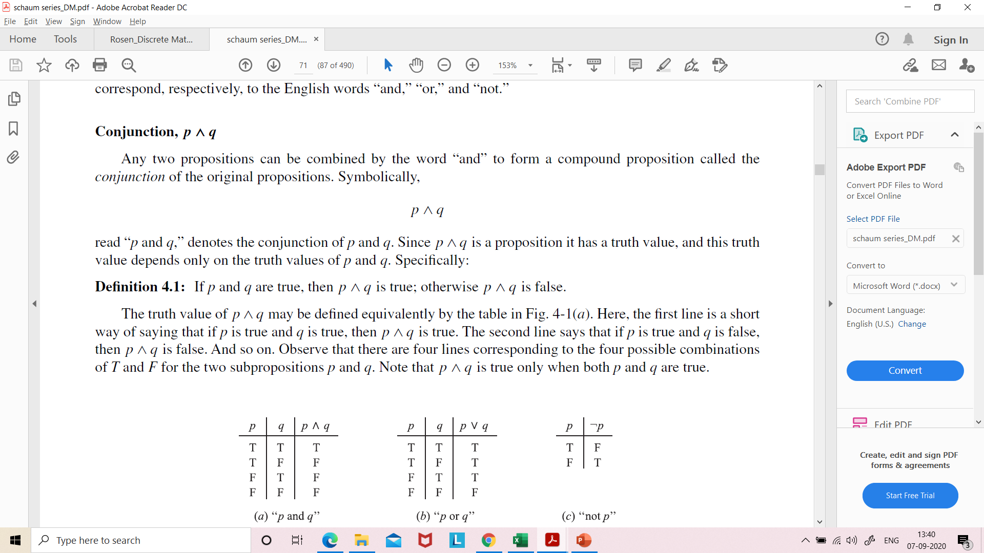
Disjunction, p ∨ q
Any two propositions can be combined by the word “or” to form a compound proposition called the disjunction of the original propositions.
Symbolically, p ∨ q read “p or q”
If p and q both are false, then p ∨ q is false; otherwise p ∨ q is true.

Slide 15
Example
If p is the proposition “Today is Friday”
and q is the proposition “It is raining today”
Then p v q will be
Today is Friday or it is raining today

Slide 16

Negation, ￢p
Given any proposition p, another proposition, called the negation of p, can be formed by writing “It is not true that . . .” or “It is false that . . .” before p or by inserting in p the word “not.”
Symbolically, the negation of p, read “not p,” is denoted by ￢p
If p is true, then ￢p is false; and if p is false, then ￢p is true.

Slide 17
Example
If p is the proposition “Today is Friday”
then ￢p will be “Today is not Friday”
or “It is not Friday today”

Slide 18

The logical notation for the connectives “and,” “or,” and “not” is not completely standardized.
For example, some texts use:
p & q, p ・ q or pq for p ∧ q
p + q for p ∨ q
p’, $\overline{p}$ or ∼ p for ￢p

Slide 19
Next topic
Conditional Statement

